Slide 1
LDaCA Technical Architecture update 2025
PT Sefton, Moises Sacal Bonequi, Ben Foley
Notes:
This presentation is an update on the LDaCA technical architecture for the LDaCA Steering Committee meeting 22 August 2025.
The architecture for LDaCA has not changed significantly for the last couple of years. We are still basing our design on the [PILARS](http://w3id.org/ldac/pilars) protocols.

Slide 2
What’s in this presentation?
News
Refresh memories of the distinction between Workspaces vs Archival Repositories
Explore the architecture of our work on Archival Repositories
Decentralised approach: multiple Data Stores under appropriate governance
Standards and specifications:
RO-Crate for describing data objects
RO-Crate Metadata Profiles for data interchange within a discipline or domain (like language data)
Open source tools
Notes:
This presentation will report on some recent developments, mostly in behind-the-scenes improvements to our software stack. It will give a brief refresh of the principles behind the LDaCA approach, and talk about our decentralised approach to data management and how it fits with the metadata standards we have been developing for the last few years. We will also show how the open source tools used across LDaCA’s network of collaborators are starting to be harmonised and shared between services, reducing development and maintenance costs and improving sustainability.

Slide 3

News!
John Ferlito (PARADISEC) has created a new version of the LDaCA portal using a simpler API that can be used for PARADISEC and LDaCA (and potentially Nyingarn and many other repositories)
New API is “An RO-Crate API” - AROCAPI
Generic API for collections of Objects/Items
Objects are described using RO-Crates
Working together on a new Oni-stack using the new API
New stack can be used for RAPID and other data portals
Notes:
This new RO-Crate API will extend portals and act as a baseline for other infrastructure that uses RO-Crates. For example, AROCAPI has basic routes (use cases) and specific configurations will be implemented (coded/programmed) for different portals.
A concrete example is that PARADISEC will implement different authentication routes (using the existing “Nabu” catalog) than the LDaCA data portal which uses [CADRE](https://cadre.ada.edu.au/login) ([REMS])(https://www.elixir-finland.org/en/aai-rems-2/).
We are evaluating the API throughout its development, rather than waiting until John finishes his work on it.

Slide 4
More news
🤞💾
Notes:
Promising discussions are taking place with one of our partners about taking on LDaCA data long-term (instead of having to distribute the collections across partner institutions). This would give a consolidated basis for a Language Data repository and a broader Humanities data service.

Slide 5
Version: 2025-07-31
LDaCA Execution Strategy Overview
Starting state (2021)
Activities
Desired state (2028)
collect &
organise
Language data is rarely organised or described in reusable ways, if it's described at all
Strengthen the data management skills of language worker communities
Develop shared tools, standards and technical infrastructure to help data stewards care for data for the long term
Build data portals with useful search functions and lightweight technical structures
Create guidance for data stewards to document and grant access and reuse rights
Support language communities to gain greater control over their language data
Develop tools for data and metadata conversion, processing, analysis, annotation, visualisation, and enrichment
Develop and guide the implementation of local and national policy and governance toolkits
Provide examples and training for research at scale
Standards and tools are available and being applied by data stewards
conserve
A lot of language data is at risk of being lost forever
Good governance and standardised, distributed storage of data helps
preserve and return data
find
It’s difficult to know what language data exists and where to find it
Discovering and locating language data is easy via linked portals
access
Processes for granting permissions and getting access to data are either absent or aren’t easy to understand or apply
Access controls are in place and easy to use, so that data access can be given to the right people
analyse
Ad hoc tools, analysis and annotation methods are used, lacking reproducibility
Shared tools can process, analyse, reuse, repurpose, annotate, visualise and enhance data at scale
> analysis overview
guide
Guidance and training for collecting, handling, using and analysing data are scattered and hard to find
Best practice advice and training for working with language data is available from a single source which is easy to find
Notes:
This slide shows the LDaCA execution strategy. All of the strands (Collect & organise, Conserve, Find, Access, Analyse, Guide) are relevant to the technical architecture.

Slide 6
Workspaces:
working storage
domain specific tools
domain specific services
Repositories: institutional, domain or both
Research Data Management Plan
Reusable, Interoperable
data objects
deposit early
deposit often
Find / Access services
describe
analyse
collect
reuse data objects
Findable, Accessible, Reusable data objects
V1.0 © Marco La Rosa, Peter Sefton 2021 https://creativecommons.org/licenses/by-sa/4.0/
Notes:
From the very beginning of the project, the LDaCA architecture has been designed around the principle that to build a “Research Data Commons” we need to look after data above all else. We took an approach that considered long-term data management separately from current uses of the data.
This resulted in some design choices which are markedly different from those commonly seen in software development for research.
Effort was put into:
- Organising and describing data using open specifications BEFORE building features into applications;
- Designing an access-control system with long-term adaptability in mind (read [the story about that](https://www.ldaca.edu.au/news/posts/fair-care-eresearch-2022/) as presented at eResearch Australasia 2022);
- Batch-conversion of existing data to the new approach; and
- Developing a metadata framework and tools to implement it.
With this foundation, and the new interoperability we gain from our collaboration on the AROCAPI API, we are well placed to move into a phase of rapid expansion of the data assets building workspace services. For example:
- The new LDaCA analytics forum will drive analytical workspaces
- Work by the LDaCA technical team will continue to improve data preparation workspaces, possibly by collaborating to adapt the Nyingarn Workspace for general purpose use.

Slide 7
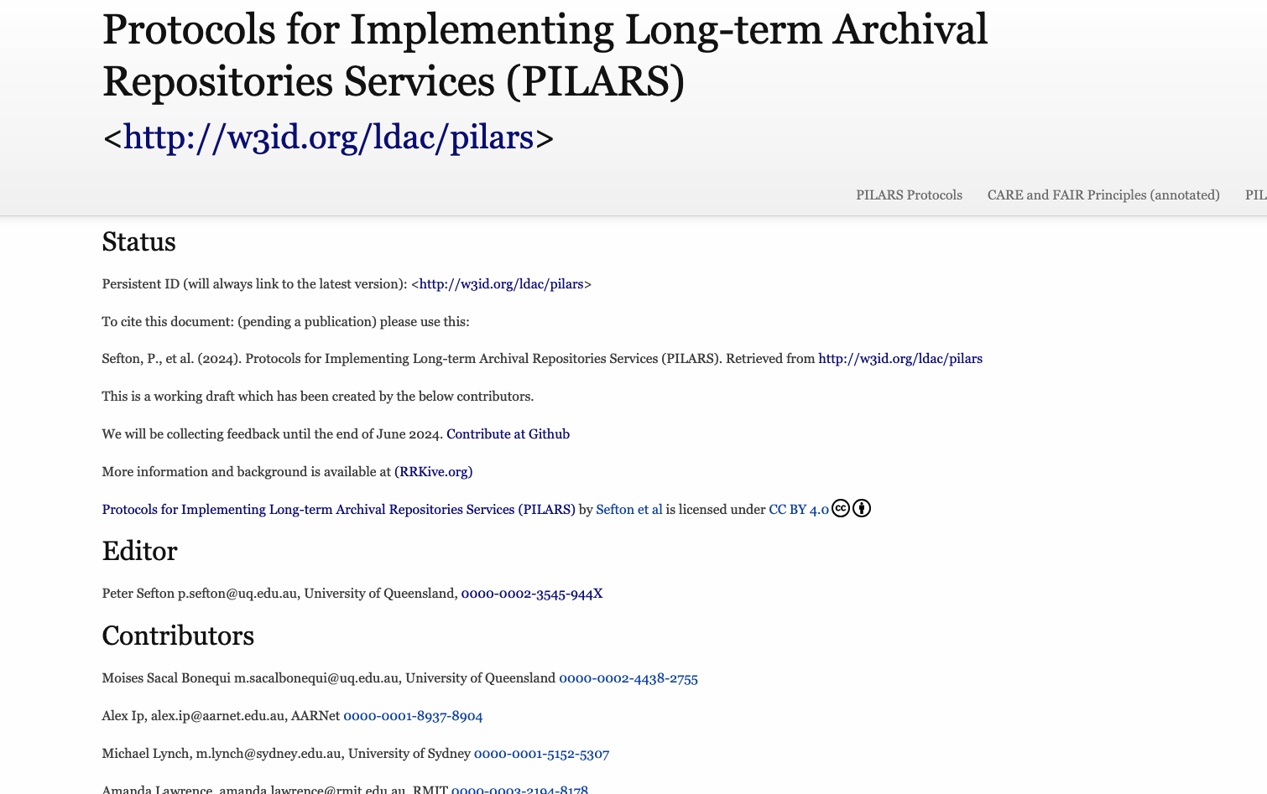
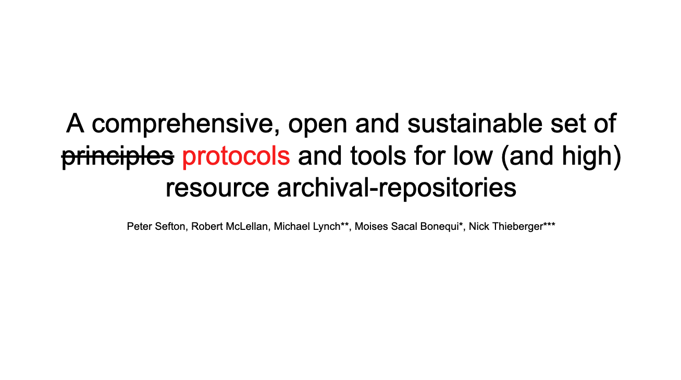
Notes:
In 2024, we released the Protocols for Implementing Long Term Archival Repositories (PILARS), described in this [2024 presentation at Open Repositories](https://www.ldaca.edu.au/news/posts/open-repositories-2024-pilars/).

Slide 8
Version: 2025-07-31
LDaCA Execution Strategy Overview
Starting state (2021)
Activities
Desired state (2028)
collect &
organise
Language data is rarely organised or described in reusable ways, if it's described at all
Strengthen the data management skills of language worker communities
Develop shared tools, standards and technical infrastructure to help data stewards care for data for the long term
Build data portals with useful search functions and lightweight technical structures
Create guidance for data stewards to document and grant access and reuse rights
Support language communities to gain greater control over their language data
Develop tools for data and metadata conversion, processing, analysis, annotation, visualisation, and enrichment
Develop and guide the implementation of local and national policy and governance toolkits
Provide examples and training for research at scale
Standards and tools are available and being applied by data stewards
conserve
A lot of language data is at risk of being lost forever
Good governance and standardised, distributed storage of data helps
preserve and return data
find
It’s difficult to know what language data exists and where to find it
Discovering and locating language data is easy via linked portals
access
Processes for granting permissions and getting access to data are either absent or aren’t easy to understand or apply
Access controls are in place and easy to use, so that data access can be given to the right people
analyse
Ad hoc tools, analysis and annotation methods are used, lacking reproducibility
Shared tools can process, analyse, reuse, repurpose, annotate, visualise and enhance data at scale
guide
Guidance and training for collecting, handling, using and analysing data are scattered and hard to find
Best practice advice and training for working with language data is available from a single source which is easy to find
Notes:
For the rest of this presentation, we will focus on recent developments in the “Green zone” – the Archival Repository functions of the LDaCA architecture. We will not be talking about the analysis stream as that will be discussed in detail in the newly established Analytics Forum.

Slide 9
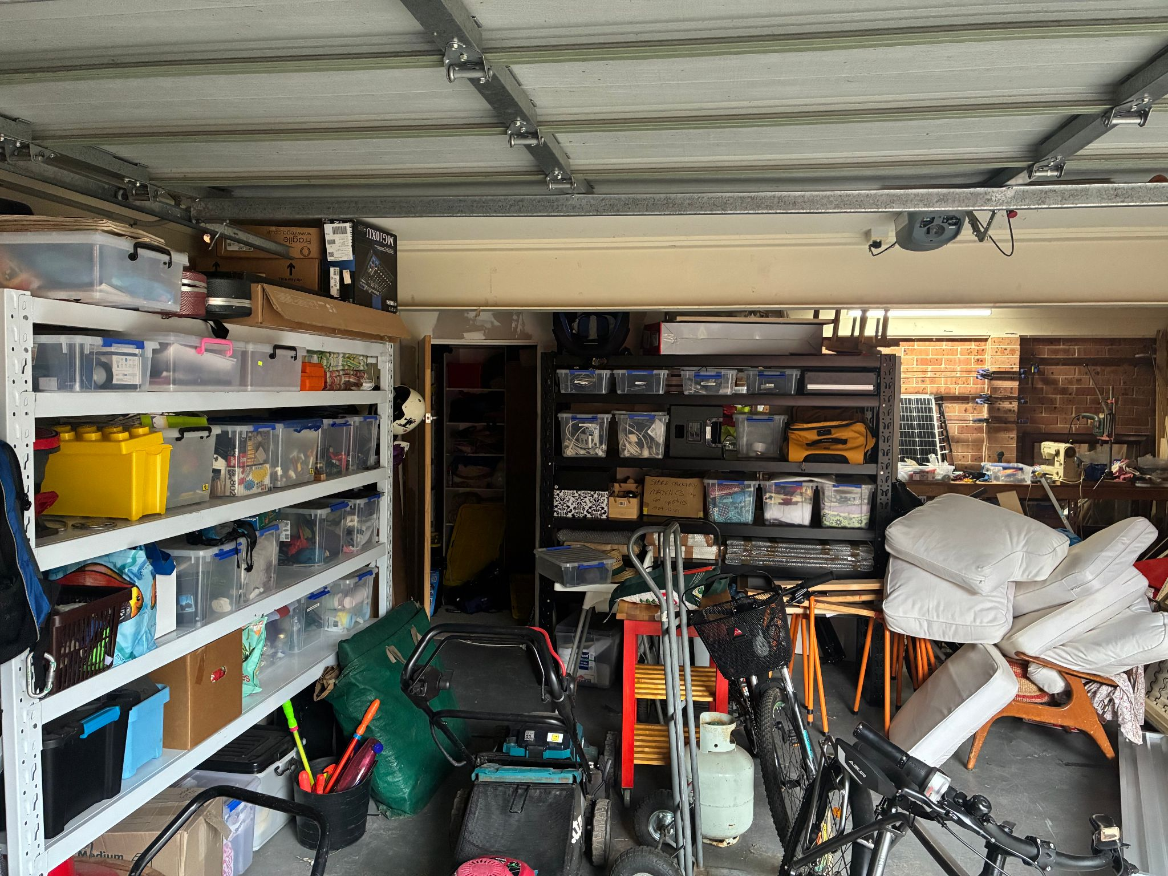
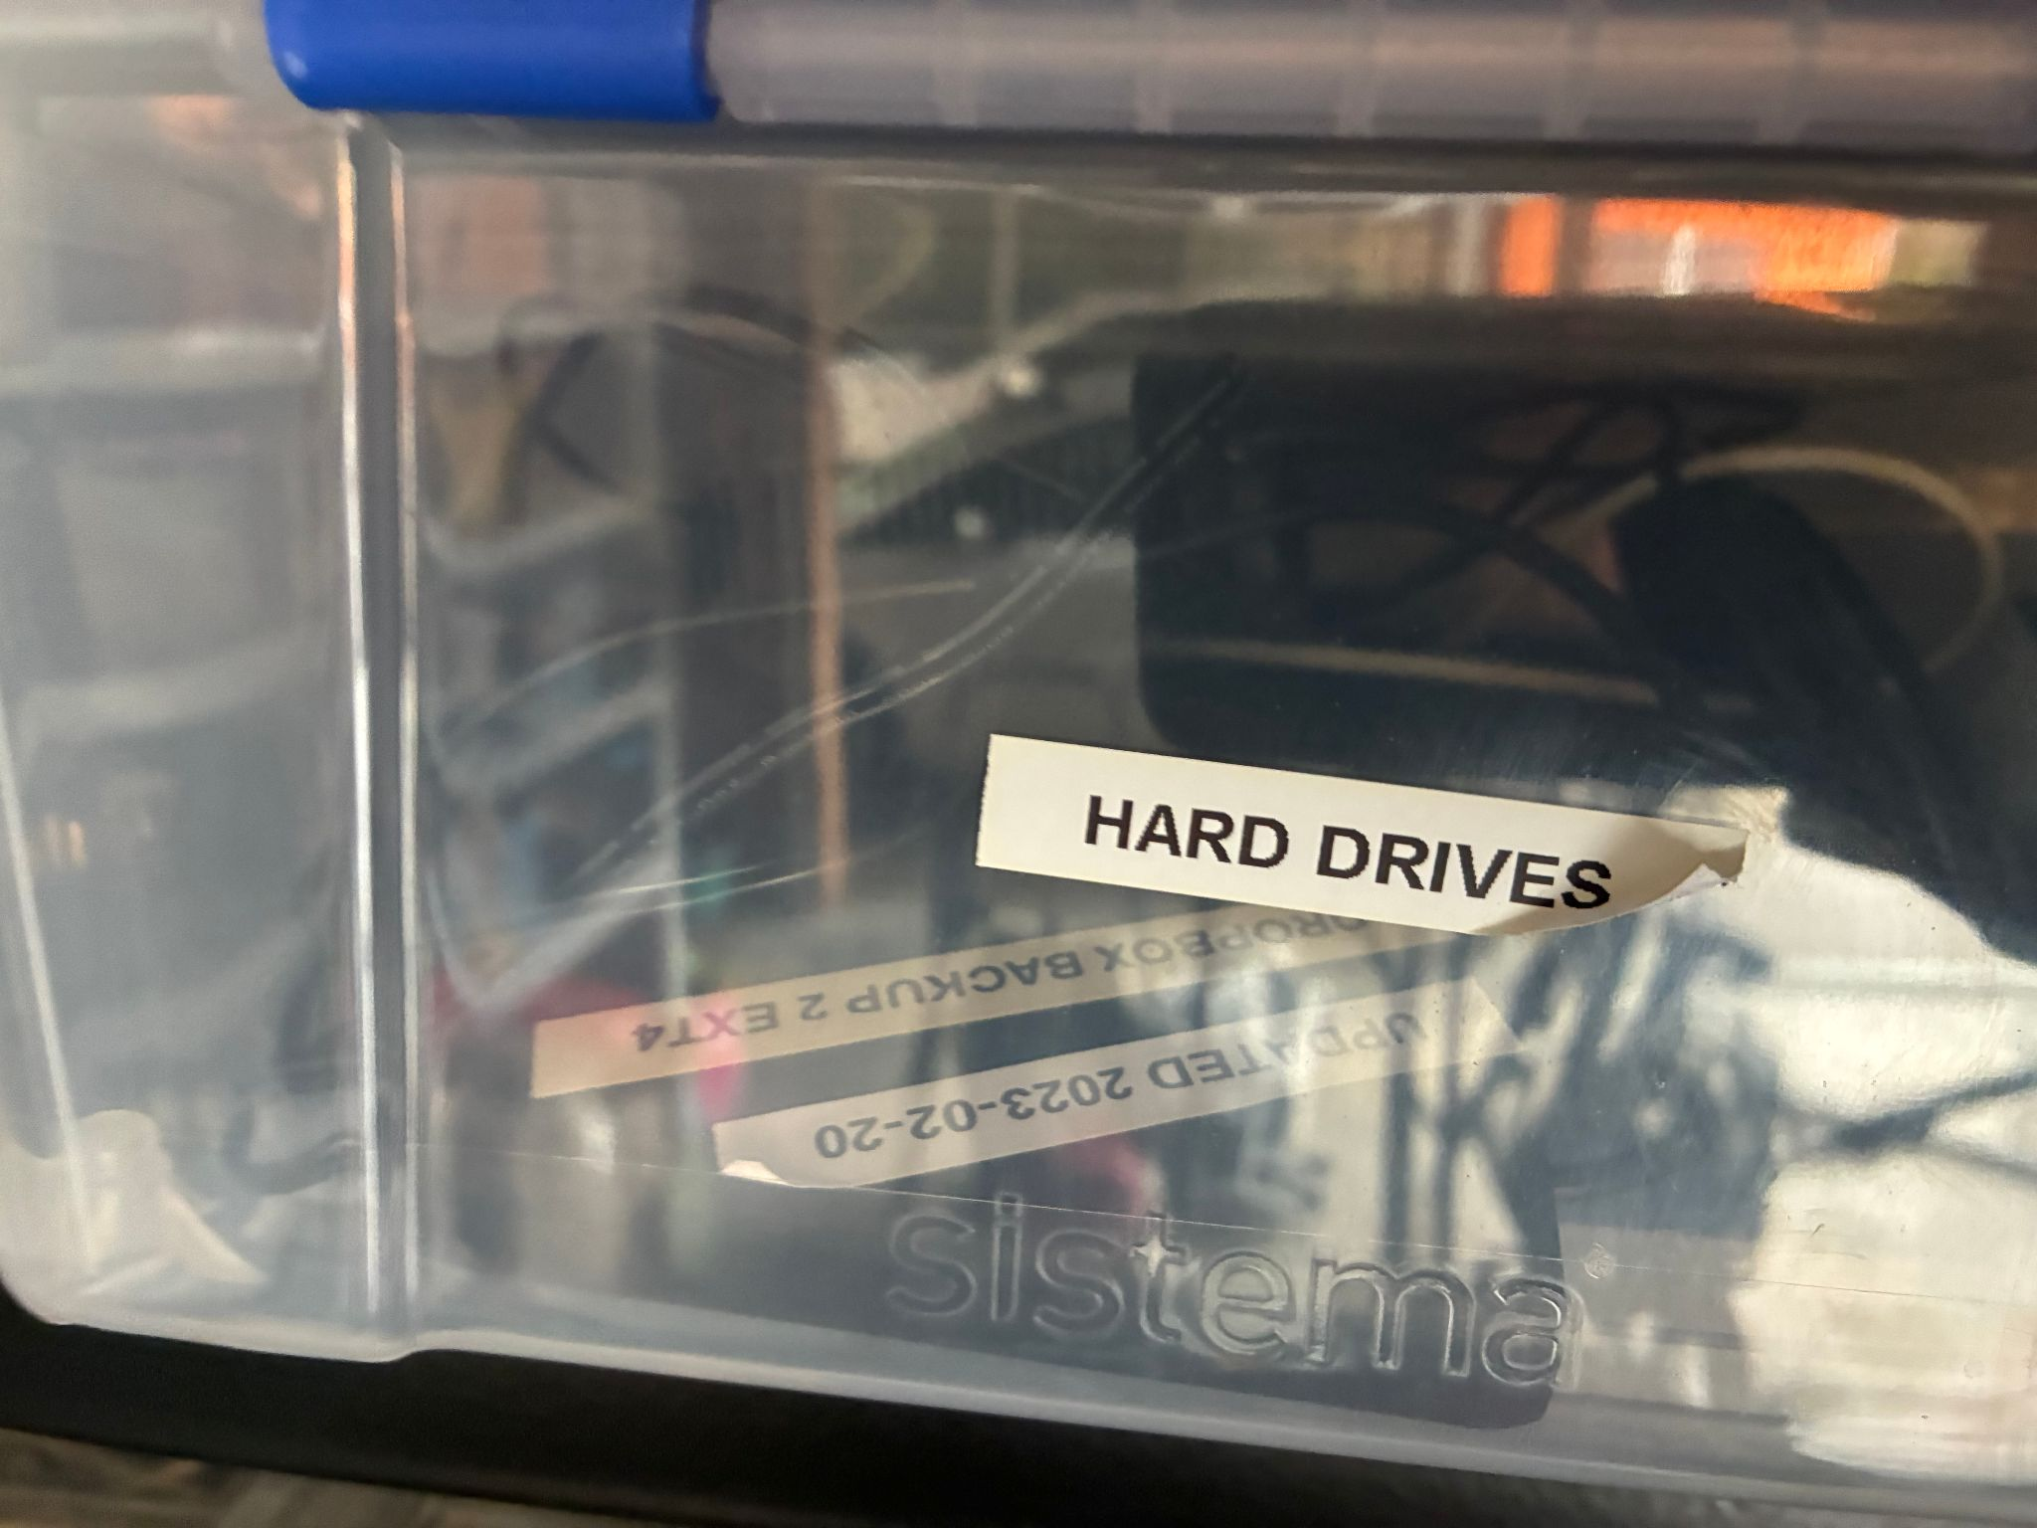
Notes:
I wanted to throw in a personal story here. This is an unstaged picture of my (PT Sefton’s) garage this morning. The box of hard drives contains some old backups of mine just in case, and also my late father Ian Sefton’s physics education research data, stuff like student feedback from lab programs in the 80s trialling different approaches to teaching core physics concepts and extensive literature reviews. These HAVE been handed on to his younger colleagues but could easily have ended up only available here in this garage. I wanted to remind us all that this project is a once in a career opportunity to develop processes for organising data and putting it somewhere alongside other data in a Data Commons where (a) your descendants are not made responsible for it and put it in a box in the shed or chuck it in a skip; and (b) others can find it, use it (subject to the clear “data will” license permissions you left with the data to describe who should be allowed to do what with it), and build on your legacy.
Remember:
- Storage is not data management (particularly if the storage is a shopping bag full of mistreated hard drives)
- Passing boxes of storage devices hand to hand is NOT a good strategy to conserve data
- Hard drives are not archives

Slide 10
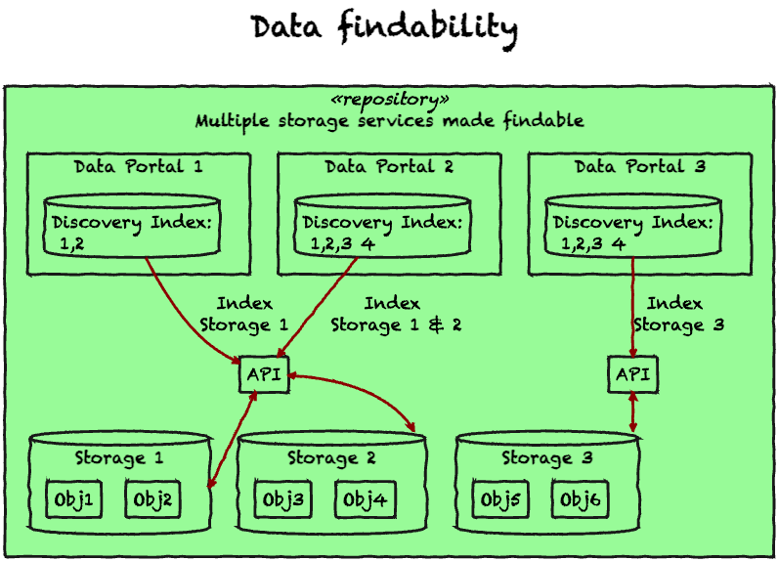
PILARS 1: Data is Portable: assets are not locked-in to a particular mode of storage, interface or service
Notes:
The first principle of PILARS is that data should be portable, not locked-in to a particular mode of storage, interface or service. Following the lead of PARADISEC two decades ago, the protocols call for storing data in commodity storage services such as file systems or (cloud) object storage services. This means that data is available independently of any specific software. This diagram is a sketch of how this approach allows for a wide range of architectures – data stored according to the protocols can be indexed and served over an API (with appropriate access controls). Over the next few slides, we will show some of the architectures that have emerged over the last couple of years at LDaCA.

Slide 11
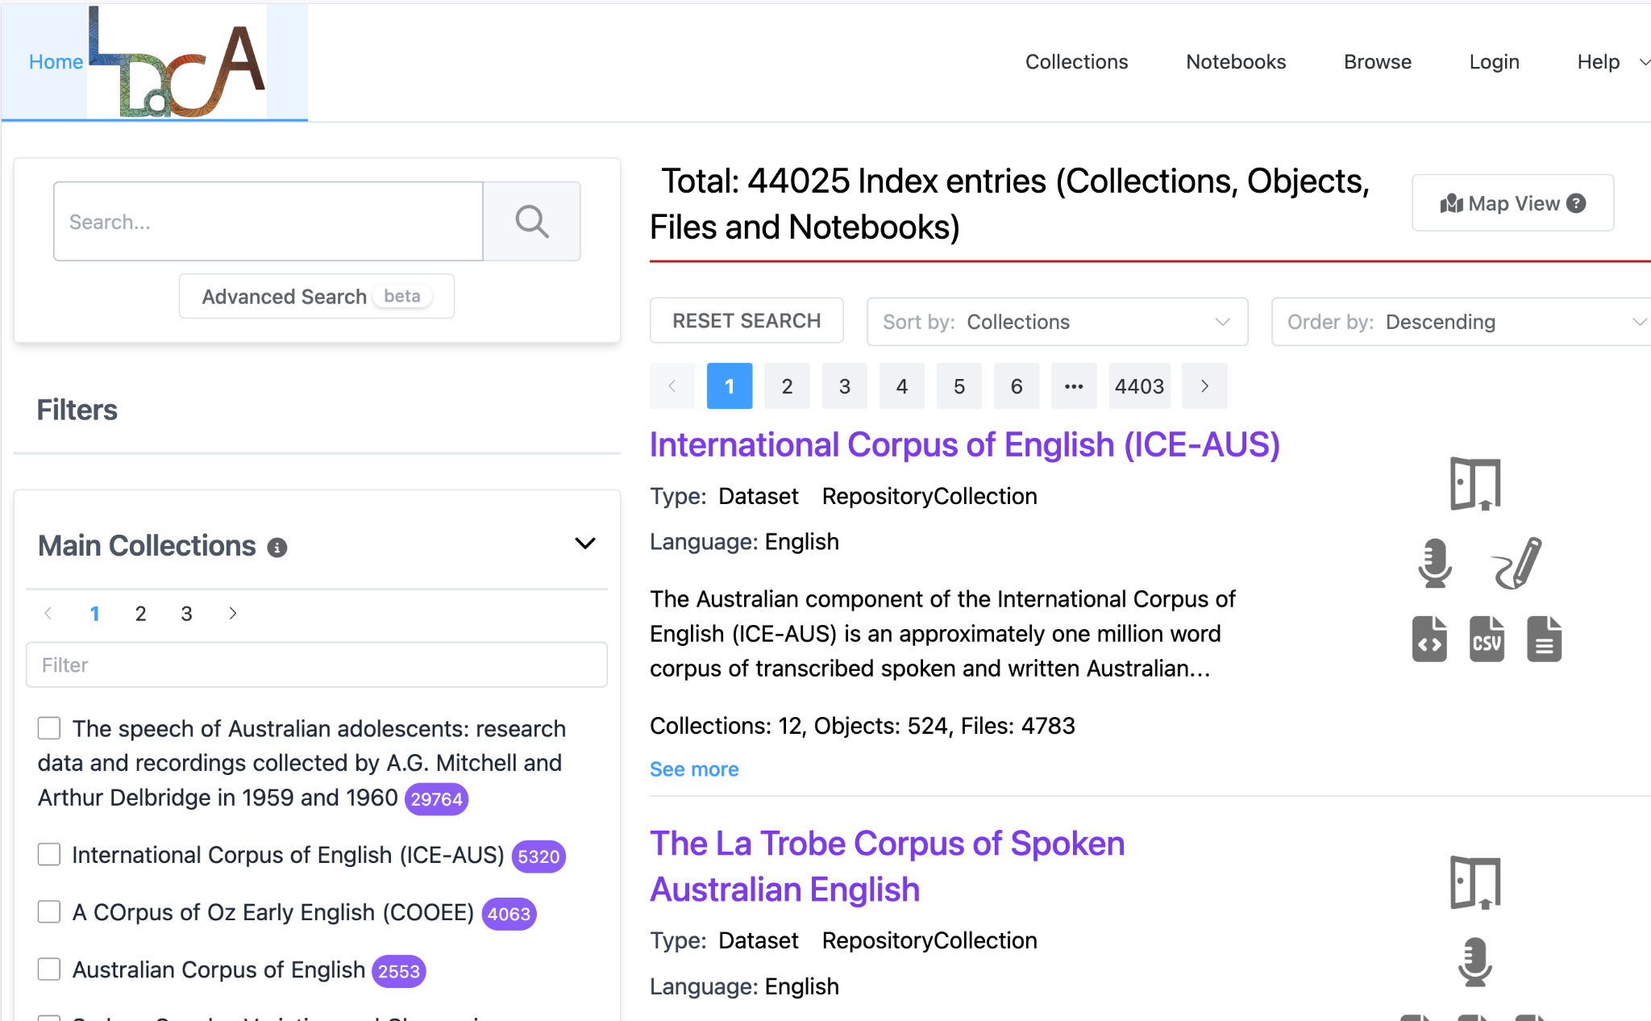
One storage service ↔ One API ↔ One Portal
This pattern will be used for LDaCA, the Batchelor CALL Collection, RAPID (Hansard) the UTS Research Data Repository and other major collections
Notes:
The first example is the LDaCA data portal, which is a central access-controlled gateway to the data that we have been collecting.
NOTE: during the project it has been unclear how we would look after data at the conclusion of the project. No single organisation had put up its hand up to host data for the medium to long term, but as noted in the News section we have had some positive talks with one of our partner institutions indicating that they may have an appetite for hosting data that otherwise does not have a home, and/or providing some redundancy for at-risk collections where data custodians are comfortable with a copy residing at the university (we won’t say which one until negotiations are more advanced).

Slide 12
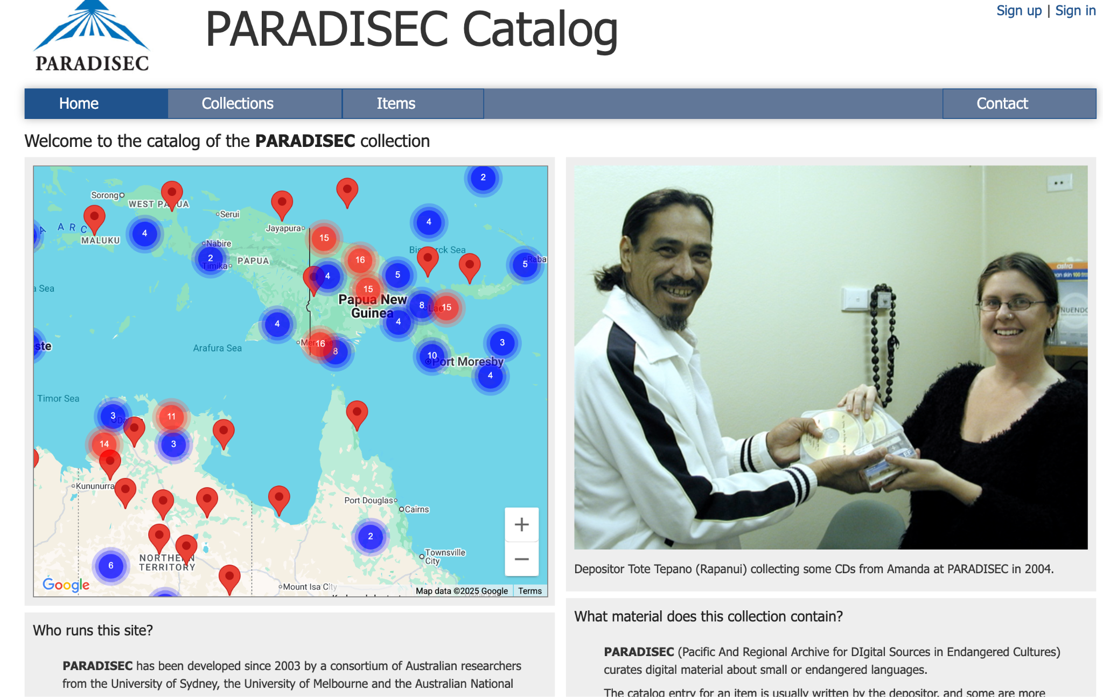
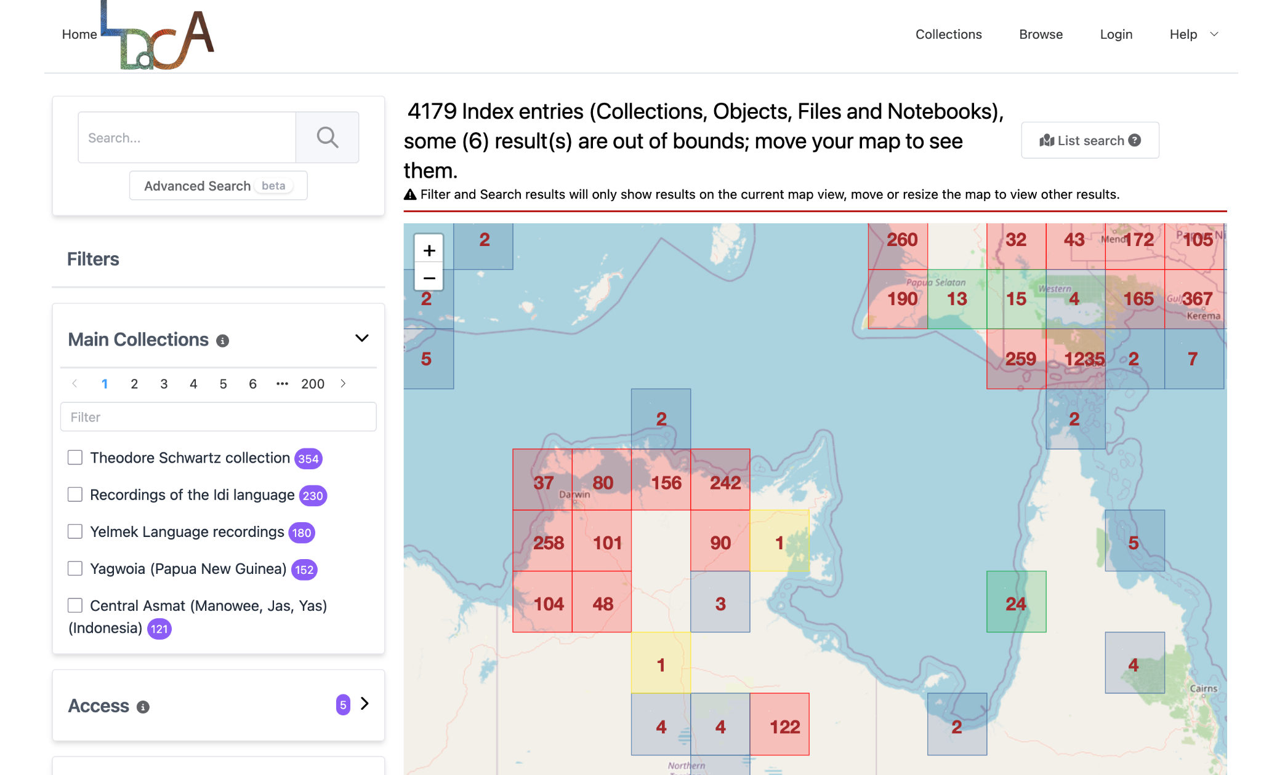
One data store ↔ One API ↔ 2 portals (demo)
DEMO ONLY
Notes:
As part of the LDaCA / PARADISEC collaboration noted above, we have been working on the definition

Slide 13
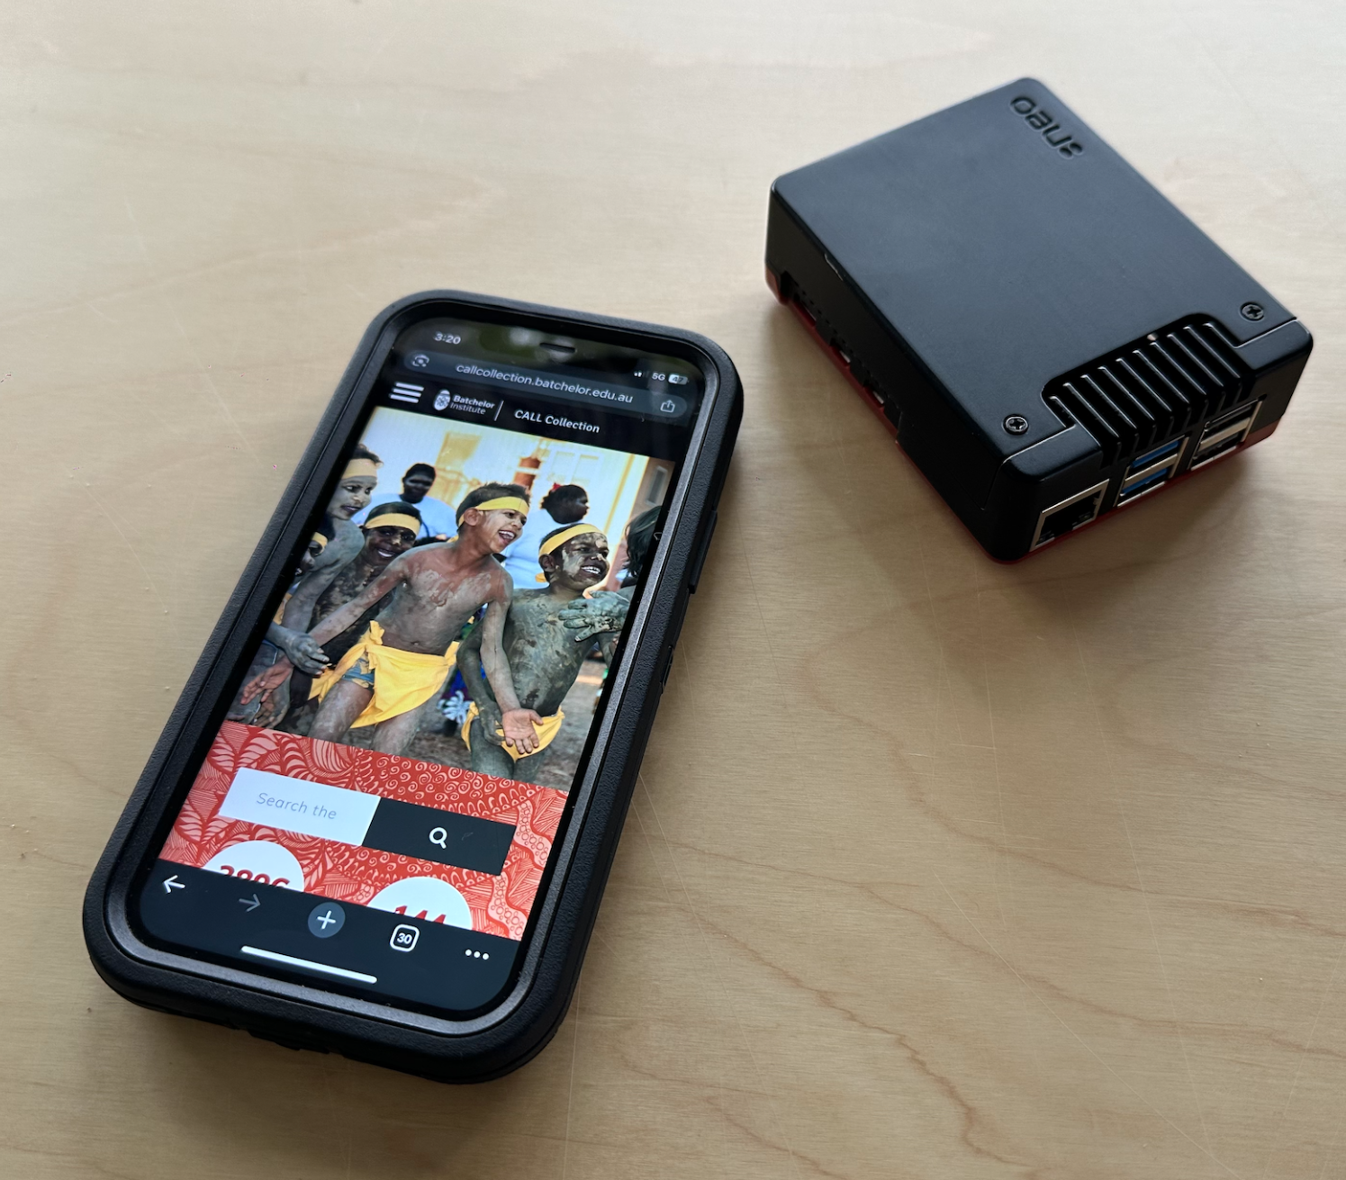

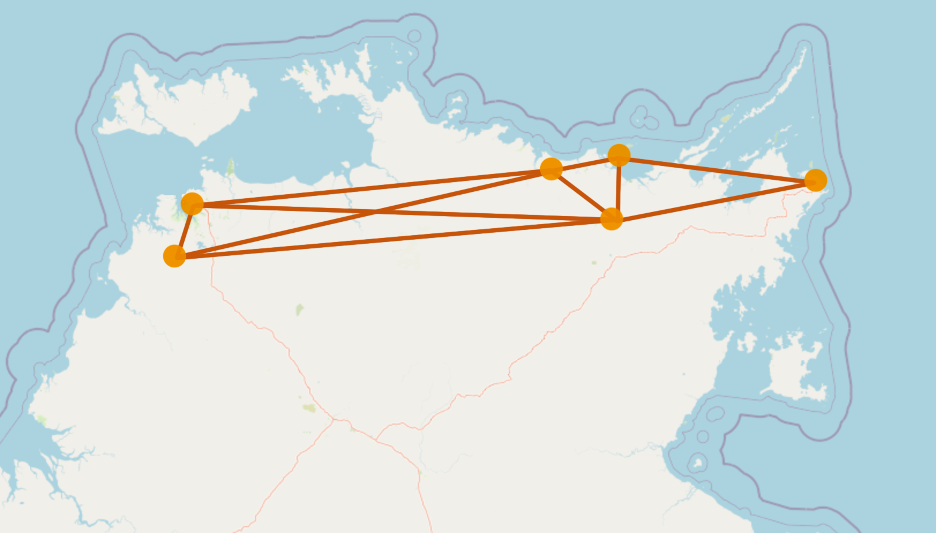
Other deployment options
Set up a stand-alone service for a specific archive (Batchelor CALL Collection work in progress)
Automation of deployment of portals on demand for testing or show and tell
Distributed regional archival repositories, local orgs share infrastructure, avoiding cloud services
Put part (or all) of a collection on a tiny computer (Raspberry Pi) for distribution
↑Raspberry Pi containing a collection
←Access on mobile via wifi
Notes:
We have also explored other ways of sharing data assets, as listed in the slide.

Slide 14
Services, software, standards and guides
Services | Standards / specs | Guides | Open Source Software
LDaCA Data Portal (oni) PARADISEC Catalogue Nyingarn Workspace RO-Crate Playground | RO-Crate specification LDaC Schema (OLAC plus) RO-Crate Profile(s) | Persistent ID policy Collections Strategy Data onboarding materials (Crate-O, spreadsheets) | Oni repo & portal Corpus tools (~30) RO-Crate libraries and tooling for editing and displaying crates and maintaining Schemas
CADRE (authorization) – ANU | CLDF
Notes:
Oni 👹 portal software for mid-to-large deployments
V1 is working
V2 under development with PARADISEC – a new shared API and code base that can be used across LDaCA and beyond
REMS - manage access control with identified users - CADRE project uses REMS
“Corpus tools” (~30) for migrating data from existing formats to LDaCA ready RO-Crate
Reduce cost of developing new migration tools by adapting existing corpus tools
Reproducible migration processes
Basis for quality assurance checks
Software libraries for managing data in RO-Crate, maintaining schemas etc
RO-Crate prep tools
Crate-O (now included in Nyingarn)
Crate-O-compatible spreadsheet templates for DIY data import and supporting familiar Excel-based workflows
LaMeta – now has RO-Crate support
RO-Crate playground to experiment with and validate metadata
Data preparation Workspaces
Niyingarn (focussed on manuscripts only ATM)
TBD – Multi-modal workspace (audio & video transcription)

Slide 15
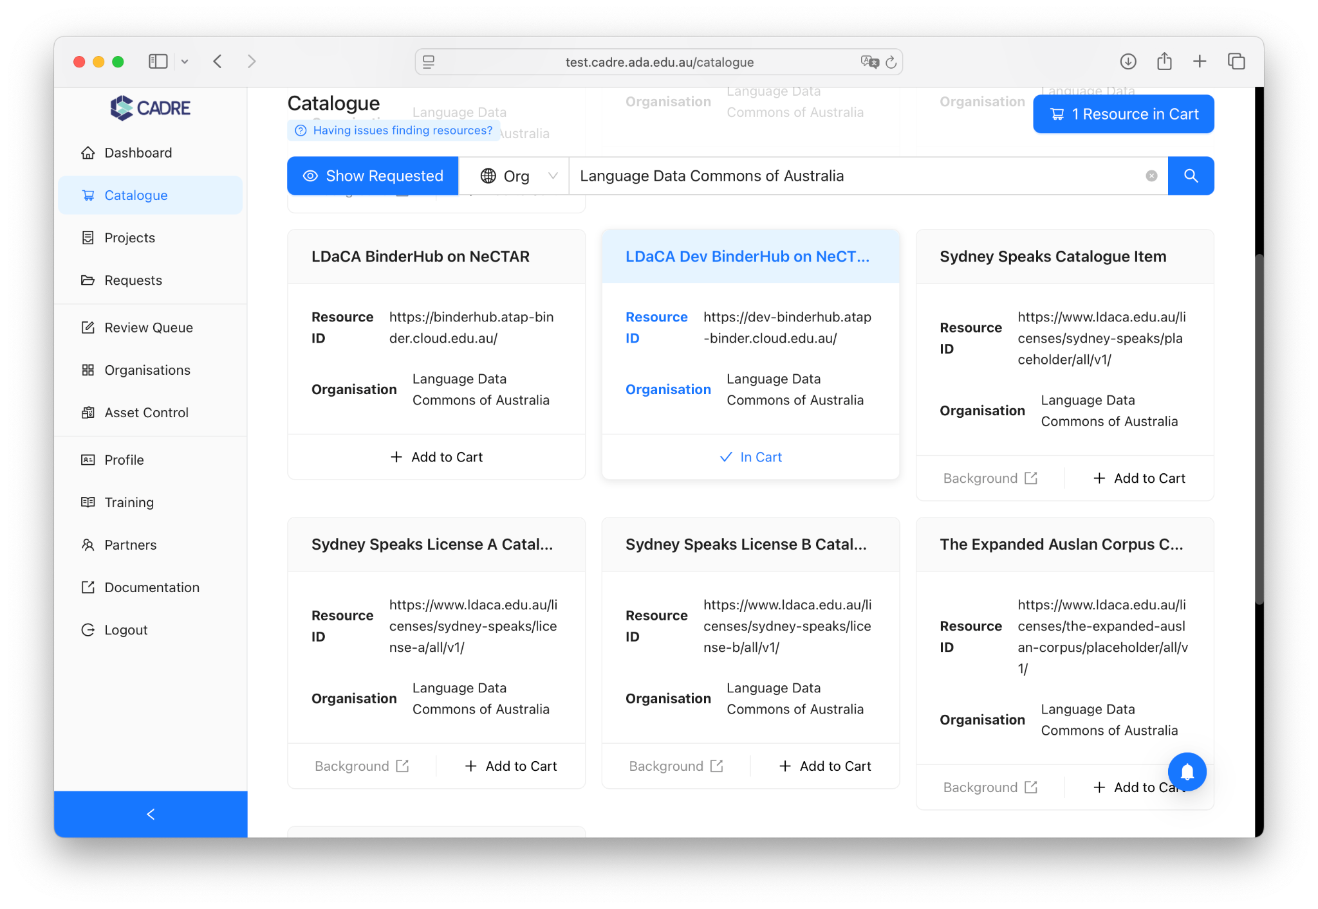
Tools
Notes:
A service agreement between LDaCA and CADRE has been signed, to manage access control.
REMS is still the backend of this tool, but CADRE built a wrapper so it looks more attractive.
CADRE version 2 is working on replacing the ADMIN component of REMS and is in testing phase now.

Slide 16
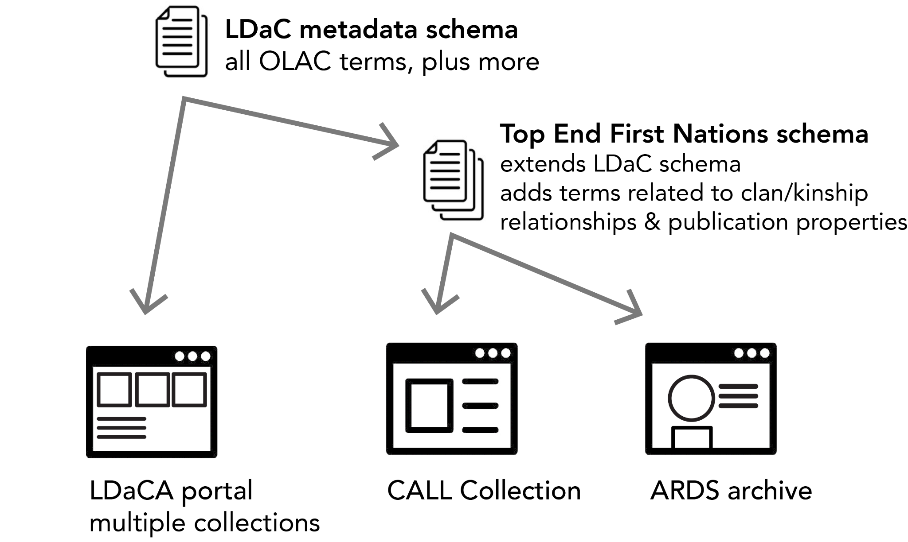
Example of standards/specs used in multiple sites
Notes:
Schemas are published online at schema.org for other organisations to use and extend.

Slide 17
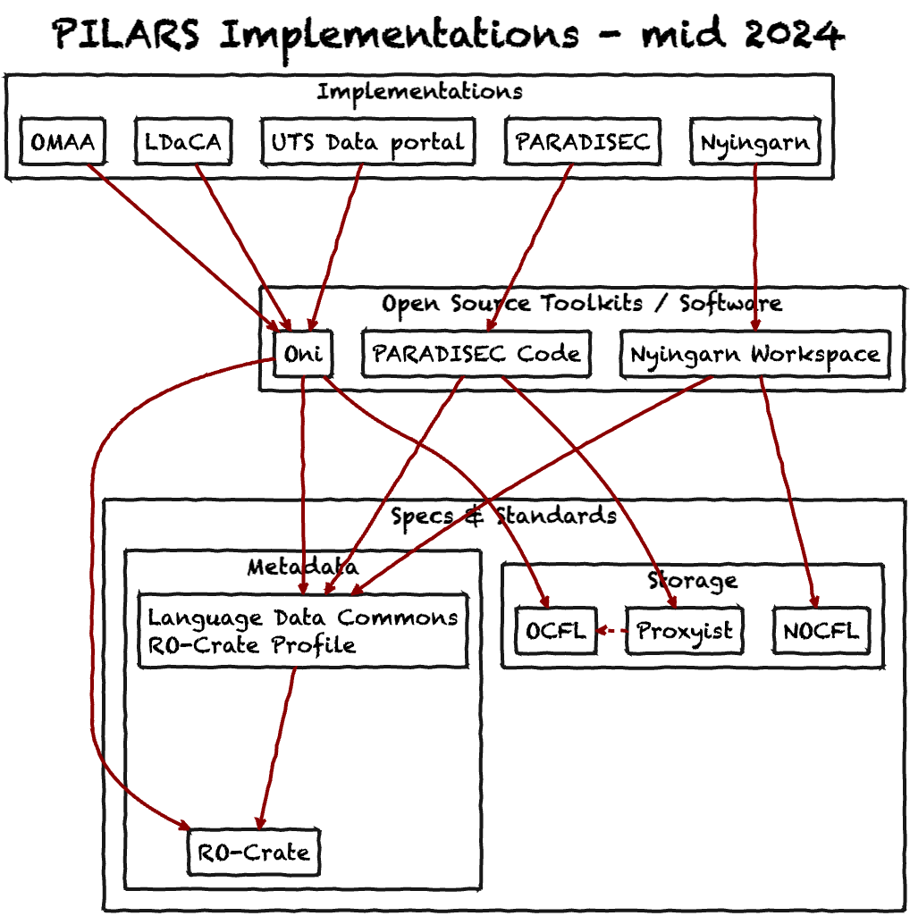
Notes:
This diagram shows how the PILARS principles have been implemented by different organisations. Each example uses open source software, and accepted standards for metadata and storage, meaning that data is portable.

Slide 18
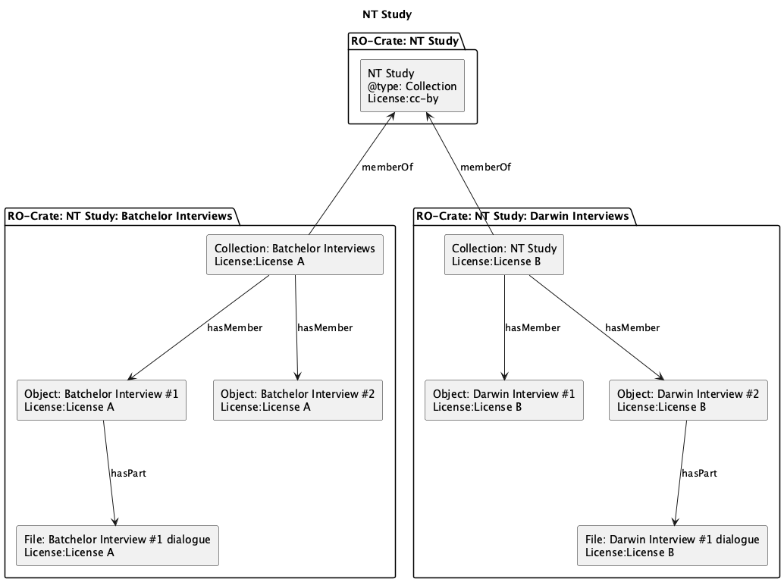
How to Store RO-Crates
Storage Objects in a PILARS repository can be linked ro-crates to a collection.
In this case a storage object is an ROCrate that is a subset of larger collection
Notes:
The ro-crates are referenced via metadata for example pcdm:memberOf

Slide 19
Portland Common Data Model (PCDM)
What it is
A flexible, RDF-based data model for digital repositories
Standardizes how to describe and relate digital objects
Core Components
Collection → groups of objects
Object → digital item (e.g., book, photo, dataset)
File → specific file representation (e.g., TIFF, PDF, MP3)
Key Features
RDF/Linked Data foundations
Modular & extensible
Supports complex structures (e.g., book → chapters → pages)
Example
📚 Digital Book
Object = the book
Files = PDF, cover image, EPUB
Nested Objects = chapters
Who Uses It
Fedora repository software
Samvera (Hydra) ecosystem
Institutions managing digital collections

Slide 20
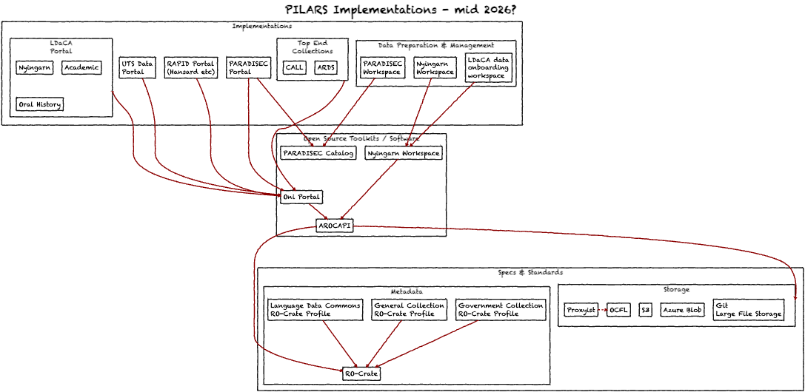
=
Notes:
This slide shows one *potential* view of LDaCA’s architecture in 2026. There may be an opportunity to deepen the collaboration between the UQ LDaCA team and the PARADISEC team at Melbourne, sharing the development of more code.
For example, Nyingarn’s incomplete repository function could be done by a stand alone instance of the Oni portal, or as shown here, added to the LDaCA portal as a collection.
Likewise the non-existent user-focussed data preparation functions of Nyigarn, where a user can describe an object and submit it could be generalized for use in LDaCA.
Changes shown in this diagram:
- Remove the under-developed “[NOCFL]” storage service from Nyingarn and replace with either OCFL or an Object Store solution
- Upgrade Nyingarn workspace to be a generic data onboarding app for all kinds of data (rather than only manuscript transcription focus)
[NOCFL]: https://github.com/CoEDL/nocfl-js
[ARDC]: https://ardc.edu.au/
To conclude, we have an opportunity now to consider how the distributed LDaCA technical team can collaborate on key pieces of re-deployable infrastructure. This work is having an impact in other Australian Research Data Commons ([ARDC]) co-investments.

